Slide 1
Auto-CiteChecker
My proposed tool for Suffolk University Law Review

Slide 2
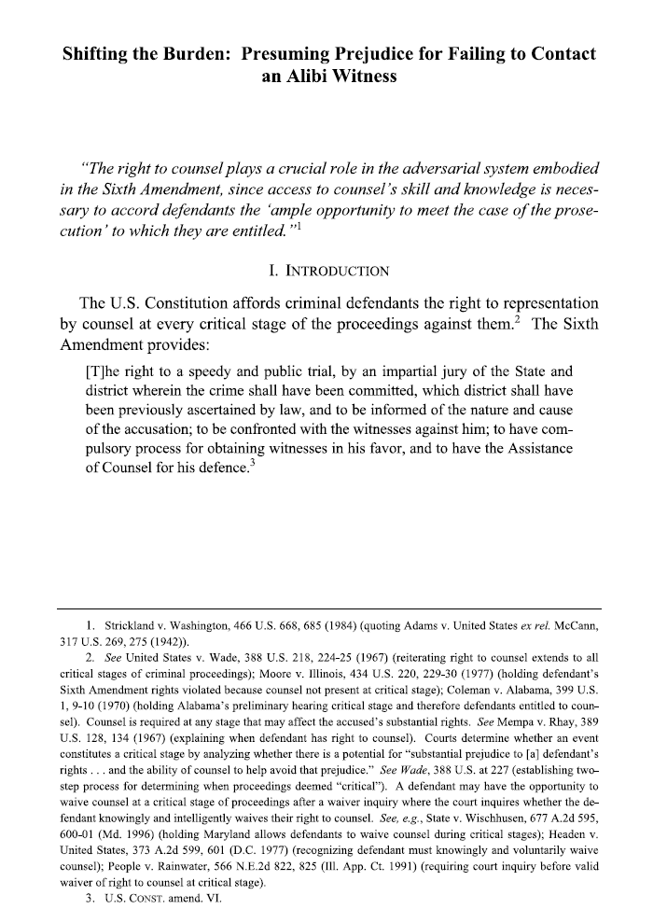
The Client: Suffolk University Law Review
The Suffolk University Law Review is a student-edited legal periodical published four times each year. The Law Review’s objective is to advance legal education and the legal profession through quality legal commentary and high publication standards. With this goal in mind, the Law Review strives to advance the growing reputation of Suffolk University Law School.
https://sites.suffolk.edu/lawreview/

Slide 3
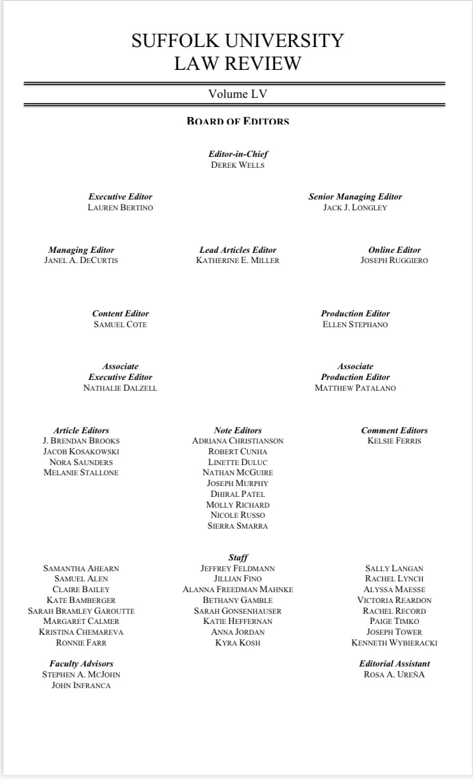

An Organizational Overview of Law Review
Author
Editor
Writes
Reviews
2L Staffers
Cite Checks
Front Office
Final Check

Slide 4

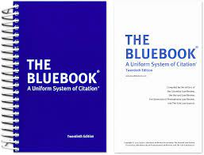
What are the Problems?
1. Cite Checking takes a long time
2. Mistakes are made when Cite checking

Slide 5

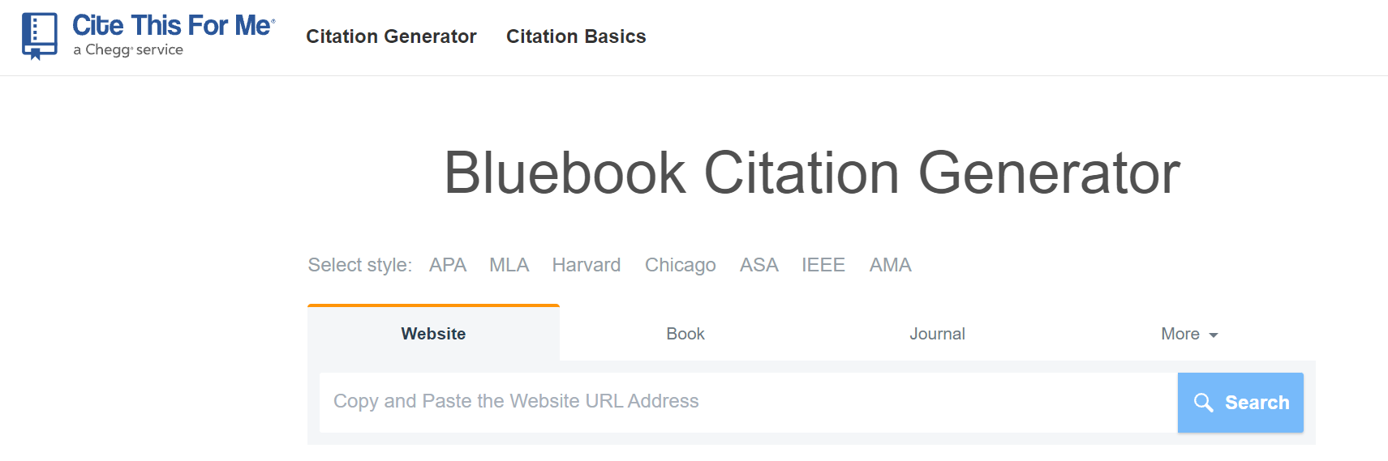
What are the current solutions to the problem?
Manually Cite Check
Buy or use a premade “Citechecker”
Problems:
Time consuming
Mistakes are made
Problems:
Not specific to Law Review
Will require Manual Cite Checking afterwards

Slide 6
Who will I be interfacing with?
For Smaller questions and issues:
Derek Wells, Editor-in-Chief
For Larger presentations:
Derek Wells, Editor-in-Chief
Lauren Bertino, Executive Editor

Slide 7
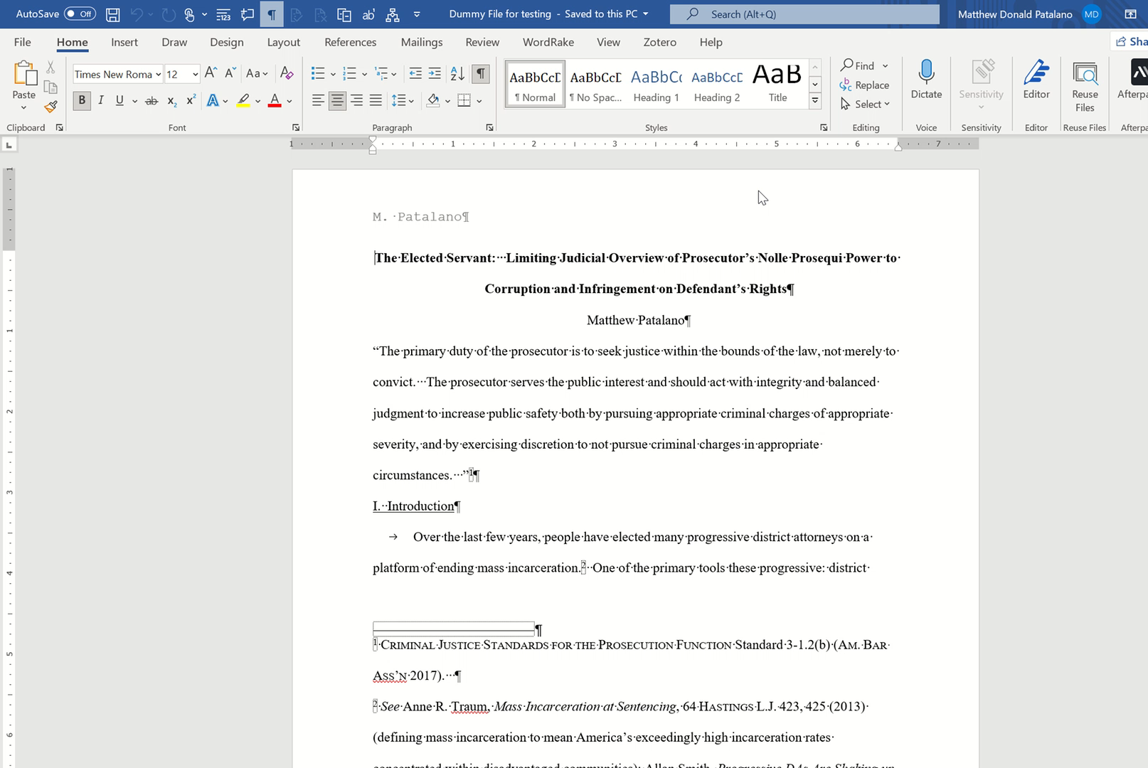
What does the solution look like Option 1: Word Macros + Regular Expressions
Pros:
Easy to use
Keeps Formation
Cons:
Relatively limited ability
No ability to group

Slide 8
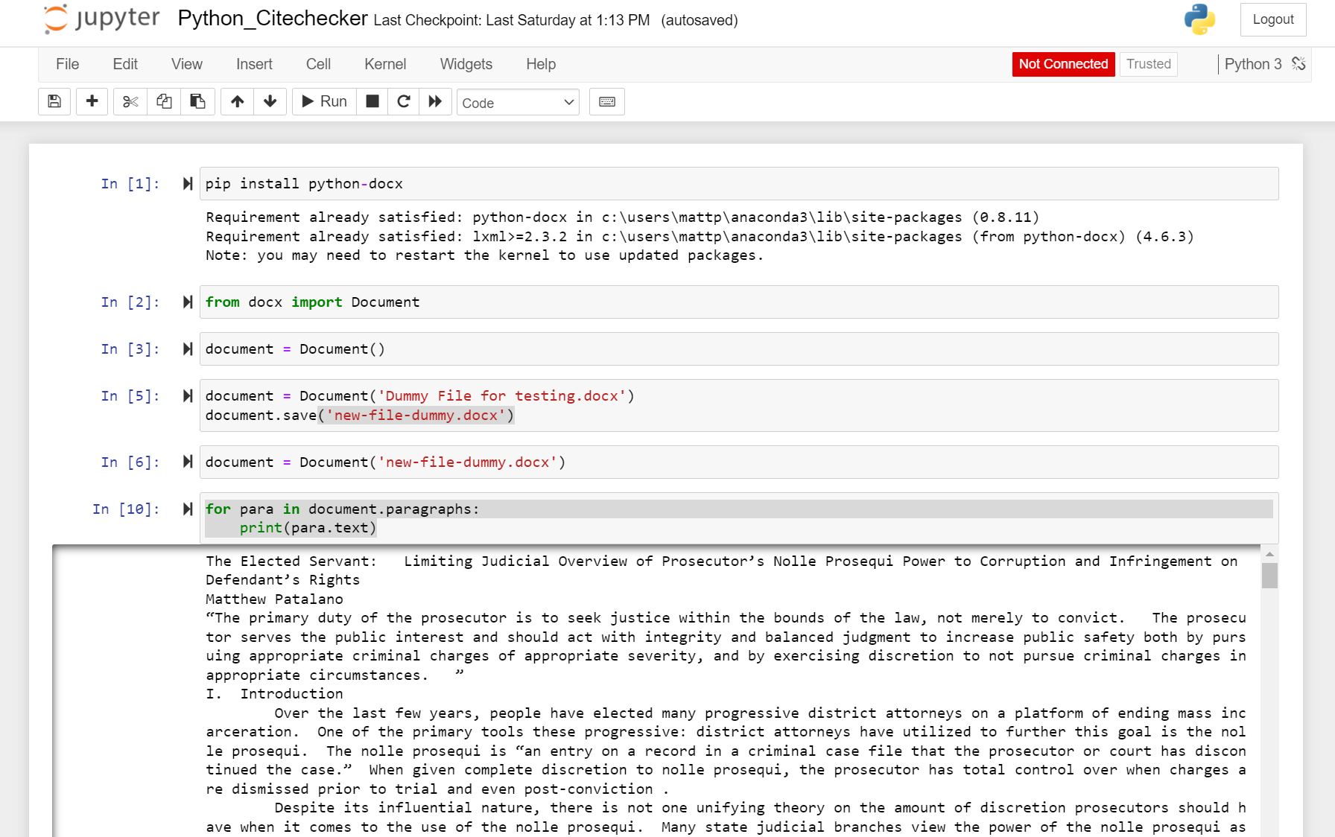
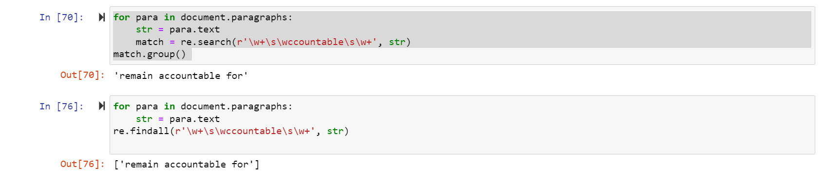
What does the solution look like Option 2: Python + Regular Expressions
Pros:
Robust Regular Expression
Able to clearly print where rules are violated
Cons:
Lots of coding required (sustainability)
Harder to make user friendly

Slide 9
Questions?

